Slide 1


Analysis of controllable points: Byu women’s tennis
Kellie Monk and Sam Kim
March 3, 2018
Notes:
Explain why this is called analysis of controllable points. Many parts of tennis can’t be controlled (opponent hitting a winner against you, acing you, forcing you to hit an error, etc) But we are showing how the CONTROLLABLE points can be improved (unforced and winner)

Slide 2


overview
Introduction
Data
Assumptions
Results
Probability Tables
Conclusion

Slide 3
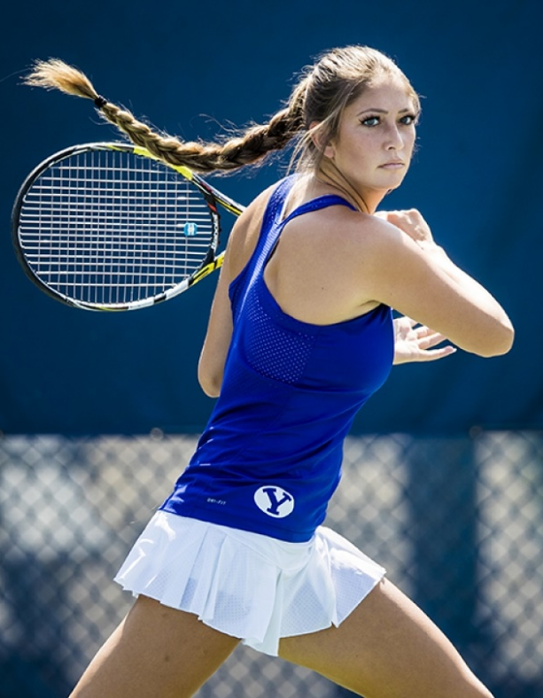
introduction
How do variables affect the probabilities of the home player hitting an unforced error or a winner?
Unforced Error vs Forced Error:
Who is responsible for the missed shot? Was the error forced by the aggressive play of the opponent or was it unforced ( i.e. just a mistake by the player who hit the shot)?
Winner:
An aggressive shot that the opponent cannot contact.

Slide 4
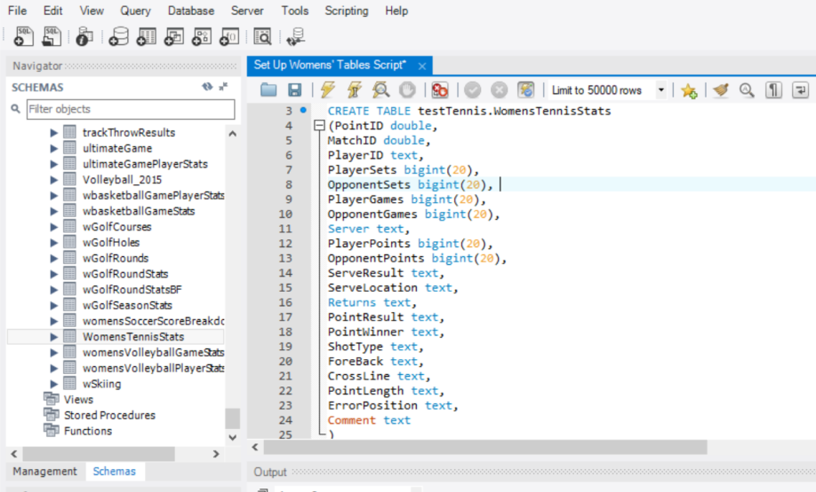
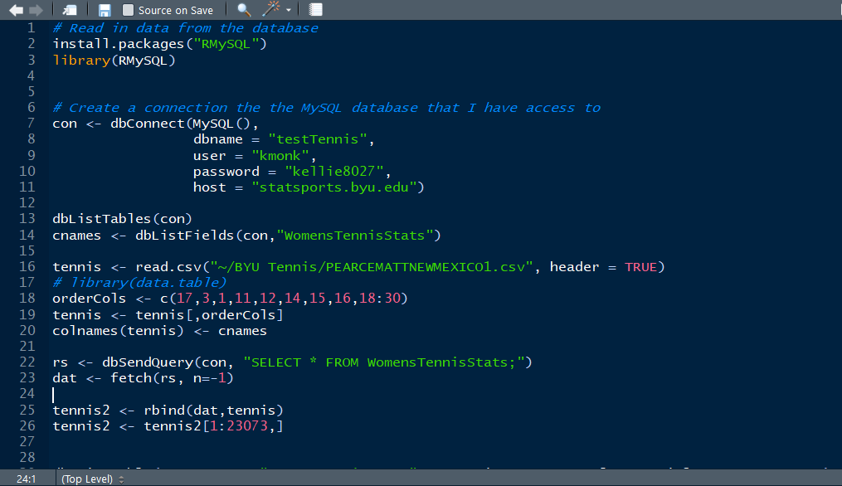
TABLE CREATION - MySQL
Since data was taken in partnership with the men’s tennis data, we created the MySQL table with the same parameters as those that exist in the men’s tennis data.
We then used R studio to insert the data into the MySQL database tables we created.

Slide 5
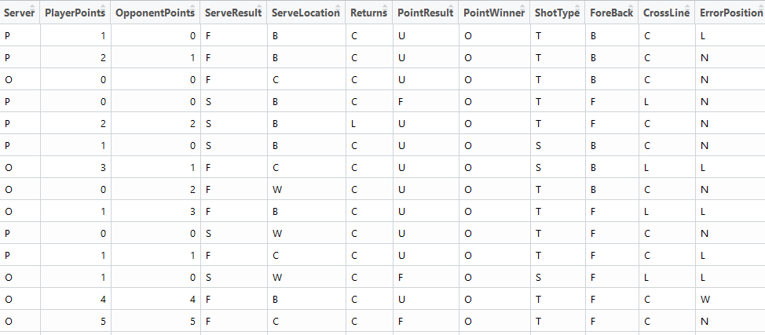
data
Data for the model is from the 2013 women’s tennis season, and were taken on the service and final shot.
Notes:
Make table bigger, explain more about the data

Slide 6
Shot type explanation
ShotTypeV - Volley
ShotTypeT - Top Spin
ShotTypeS - Slice
ShotTypeD - Drop Shot
ShotTypeO - Overhead
ShotTypeL - Lob
ForeBackF - Forehand
ForeBackB - Backhand
CrossLineC – Cross court
CrossLineL - Down the line

Slide 7
Verifying ASSUMPTIONS
In logistic regression, the variable of interest must be binary. Each respective result (Unforced Error or Winner) the result of interest was coded as a 1, and all other results as 0s.

Slide 8
Results(WINNERS overall)

Slide 9
Results(unforced errors overall)

Slide 10
Probability of Winner By Shot
Notes:
Create a color coded legend by intervals, make table bigger

Slide 11
Probability of Unforced errors by shot
Notes:
Highlight the entire row

Slide 12
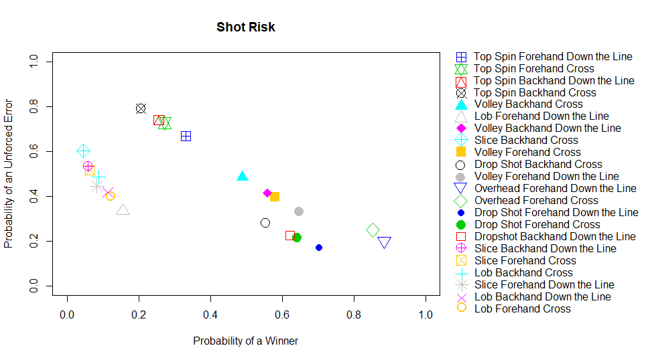
Shot risk plot

Slide 13
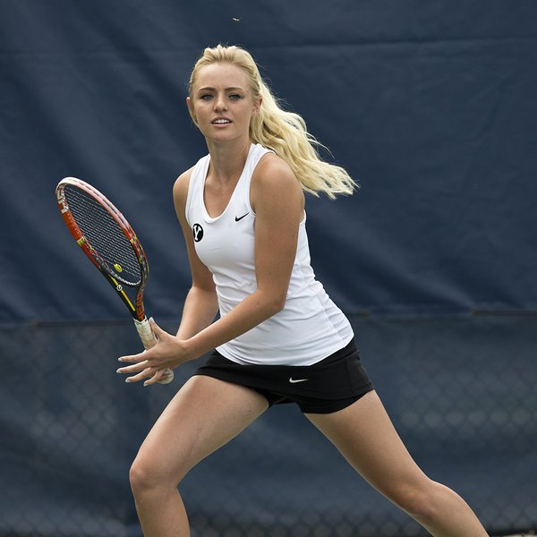
Conclusion
The lowest risk, highest reward shots were the forehand overhead cross court and down the line shots.
The highest risk, lowest reward shots were the slices and lobs.

Slide 14
Improvements
In the future, change the way data are taken in order to generate the probability of forcing an error.
Apply this model to this season’s data.
Run the same model for each player once sufficient data has been collected.
Share these results with Coach Jones this season.
Notes:
* Eventually want to subset by player once sufficient data has been collected for each player.

Slide 15
Questions?

